Slide 1
Air quality modeling
To what extent can forest treatments mitigate risks to communities from smoke?

Slide 2
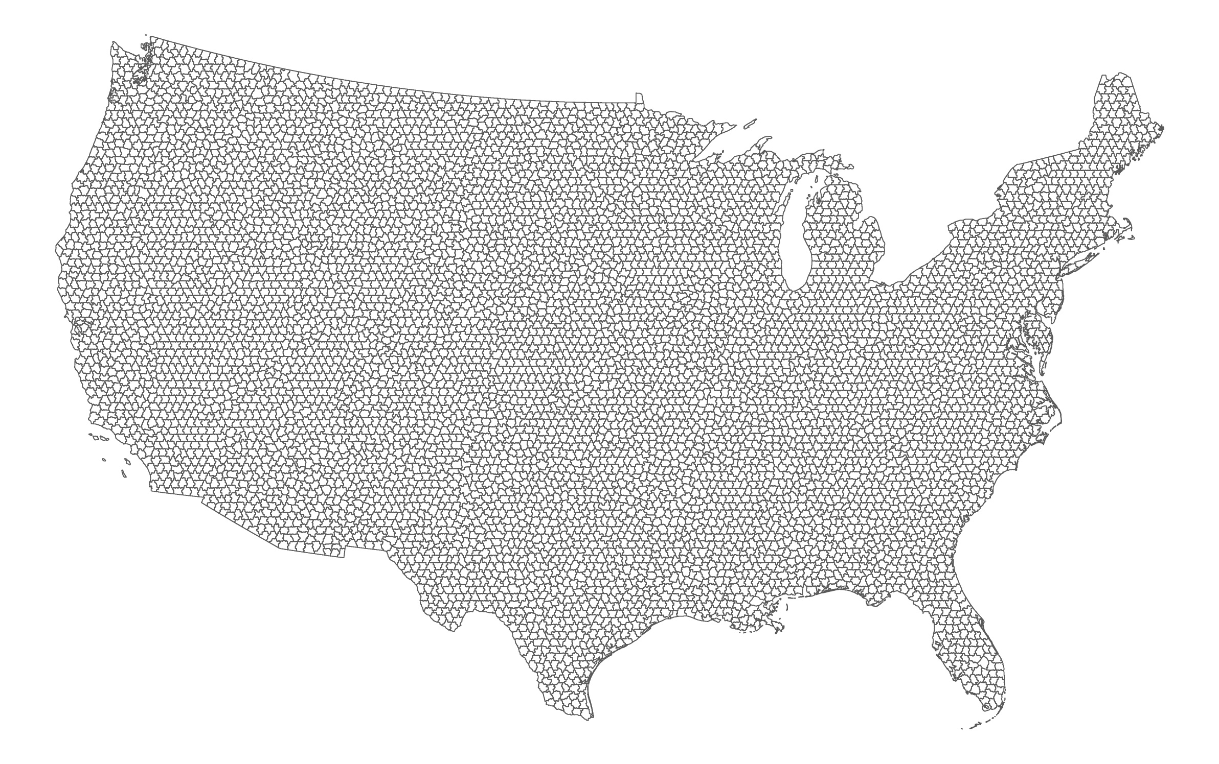
Modeling emissions at fireshed scale (n = 7,688)

Slide 3
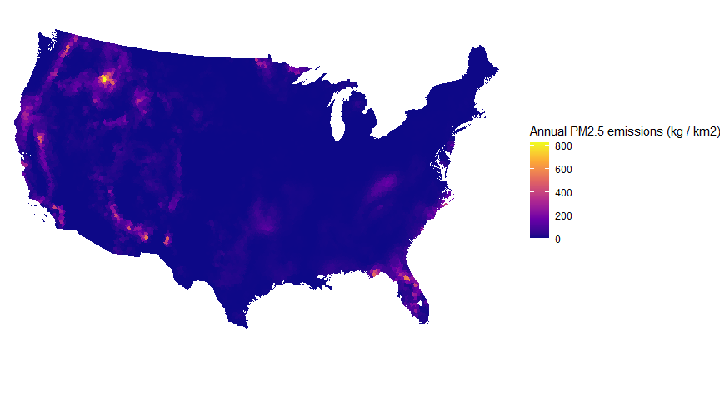
Where do emissions come from?
Data shown: Fsim (will be updated to Flamstat)

Slide 4
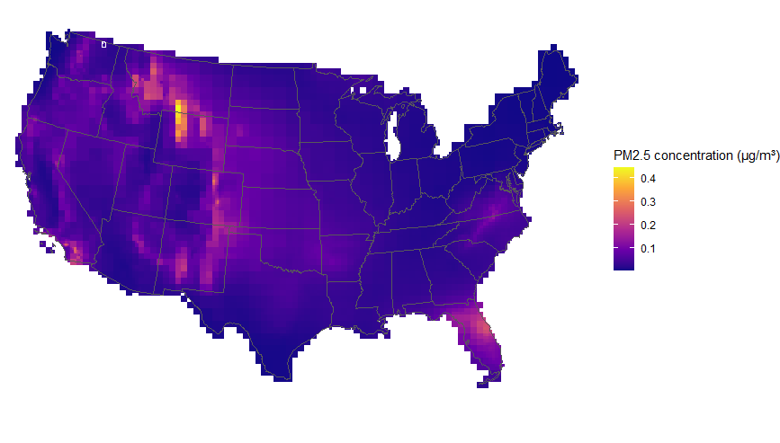

Where do emissions end up? (1000-m plume rise)
Using InMAP air quality modeling

Slide 5
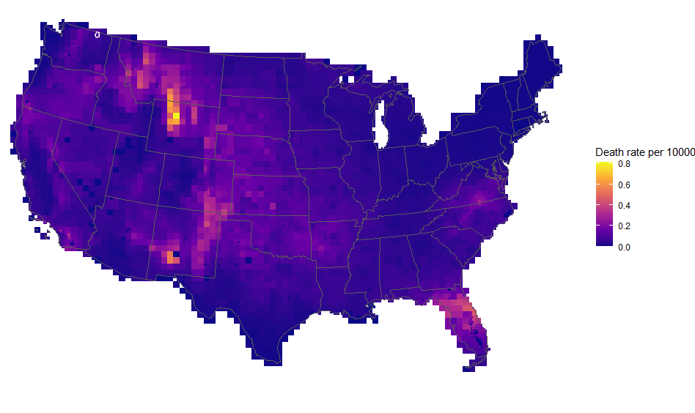
Death rate

Slide 6
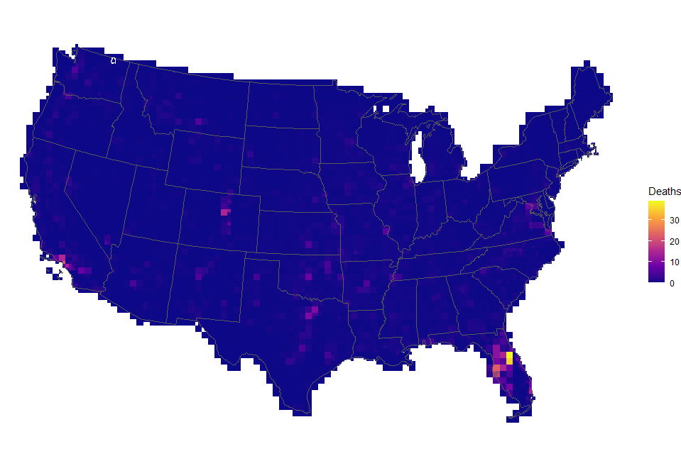
Total deaths

Slide 7
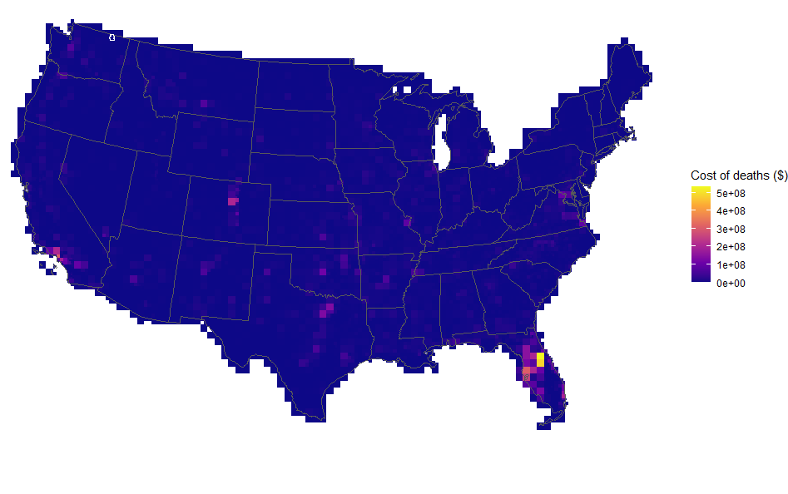
Assuming statistical value of life at $13.6 million → cost of $24 billion / year
Federal firefighting budget is $3-4 billion / year

Slide 8
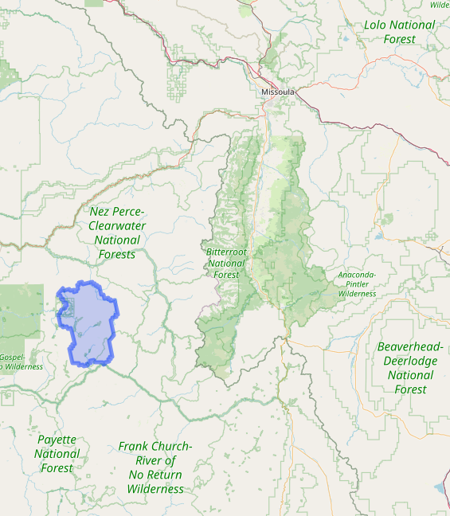
We can tie risk back to the forested pixel

Slide 9
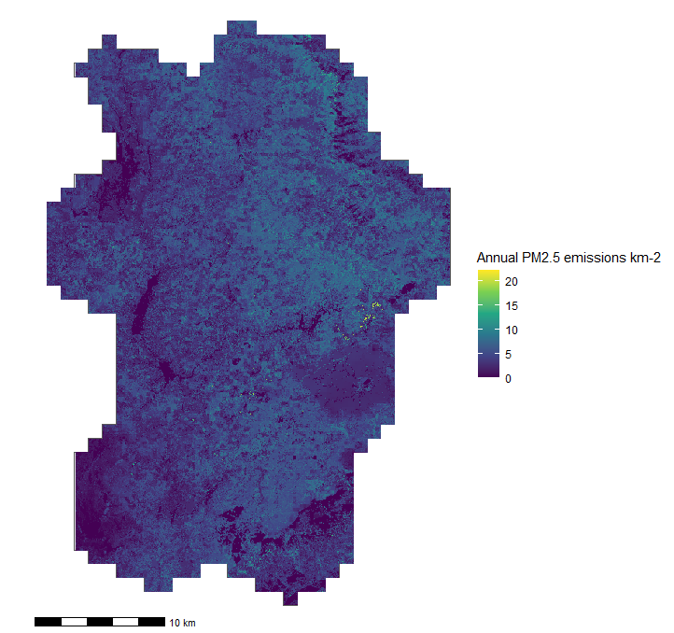
Where do emissions come from?

Slide 10
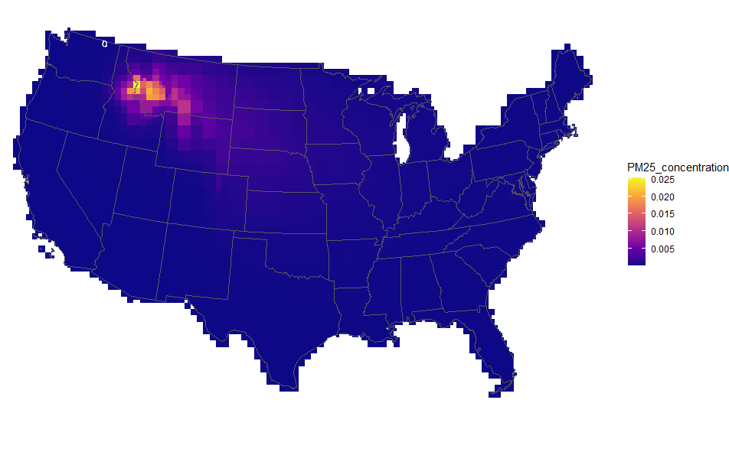
Where do emissions end up?

Slide 11
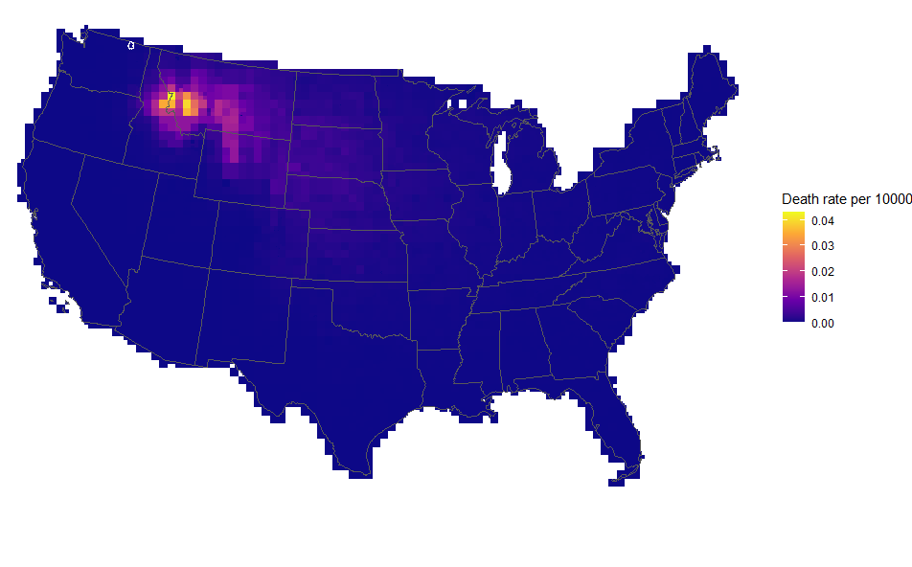
Death rate

Slide 12
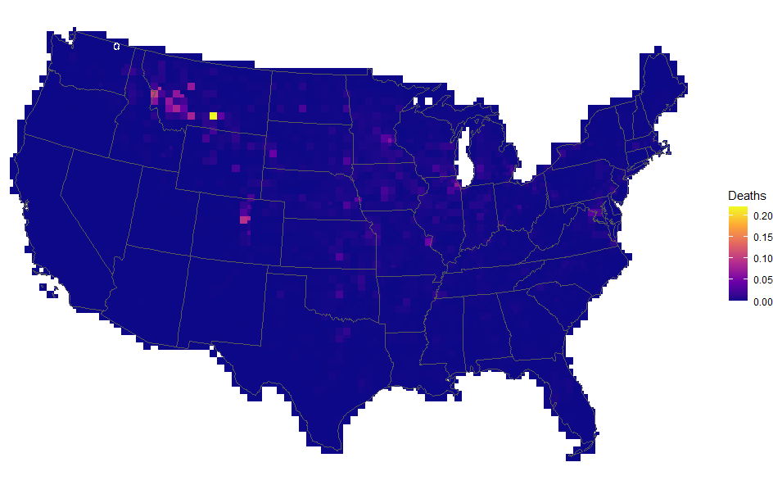
7.097 total deaths

Slide 13
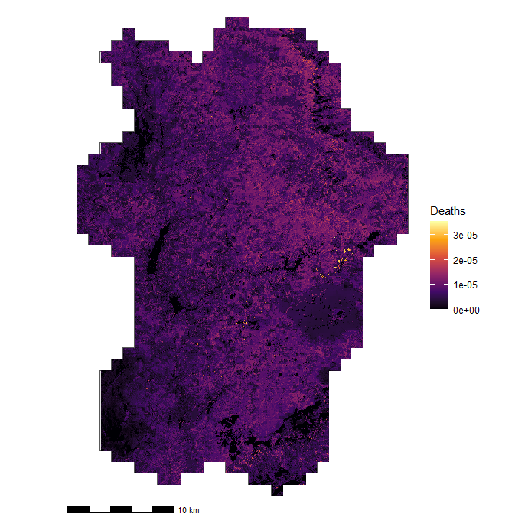
7.097 total deaths
Allocate risk based on proportion of emissions

Slide 14
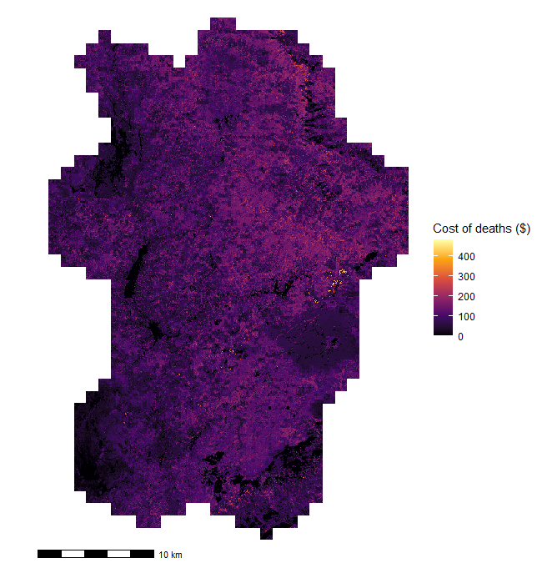
$97 million total (per year)

Slide 15
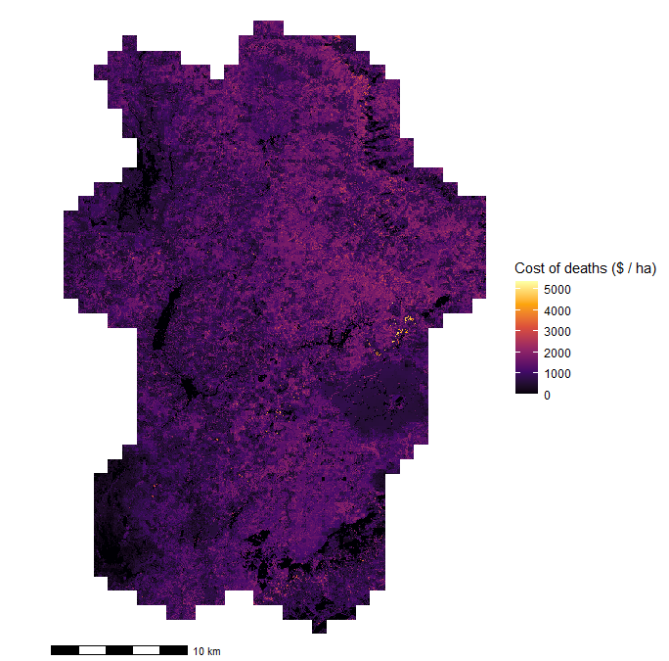
Cost per hectare (per year)
Cost of forest thinning
$758–$4,291 per ha
Chang, H., Han, H.-S., Anderson, N., Kim, Y.-S., & Han, S.-K. (2023). The cost of forest thinning operations in the western United States: A systematic literature review and new thinning cost model. Journal of Forestry. 2022: 1-18., 2022, 1–18. https://doi.org/10.1093/jofore/fvac037

Slide 16
Compare “baseline” emissions to treated landscape
Using Flamstat fire modeling: 1) Rx fire; 2) Thin & burn

Slide 17
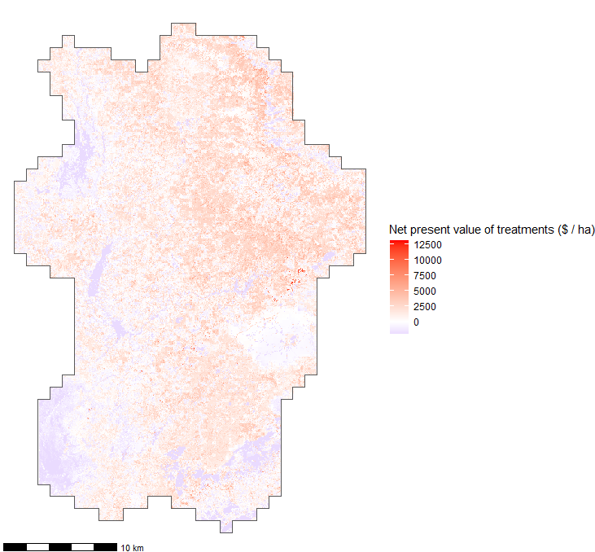
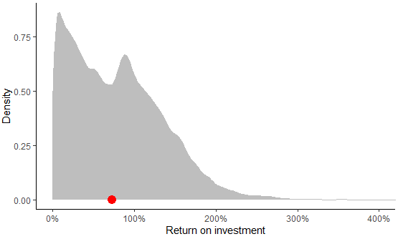
Look at Net Present Value of treatments
Assumptions:
Treatments are effective for 5 years
Treatments reduce emissions by 50%*
Yearly discount rate of 2.5%
Doesn’t include all the other benefits of treatments!
If you treat all cost-effective pixels:
Median of $1458 saved (beyond treatment cost)
Median return on investment of 73%
*We will know this once we have treatment Flamstat runs

